Slide 1
Design for Verification Project Update
2020-02-01
Eldrick Millares (eldrick@stanford.edu)

Slide 2
Last Week’s Tasks
Refactor Symbolic Starting States / Hardware Trojan Materials
Insert and Detect 5 Hardware Trojans on VScale
Formulate Assertions for Symbolic Starting States Constraints

Slide 3
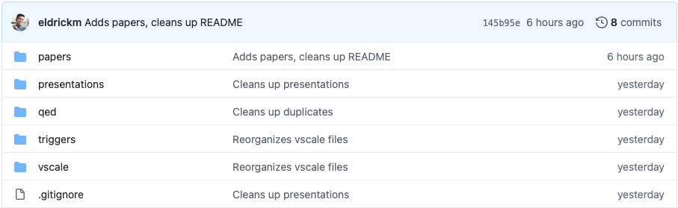
Status Updates - Clean Up / Refactor
https://github.com/eldrickm/sqed_sss.git
Notes:
Collected relevant papers and drafts
Added presentations hidden away
Improved documentation and infrastructure

Slide 4
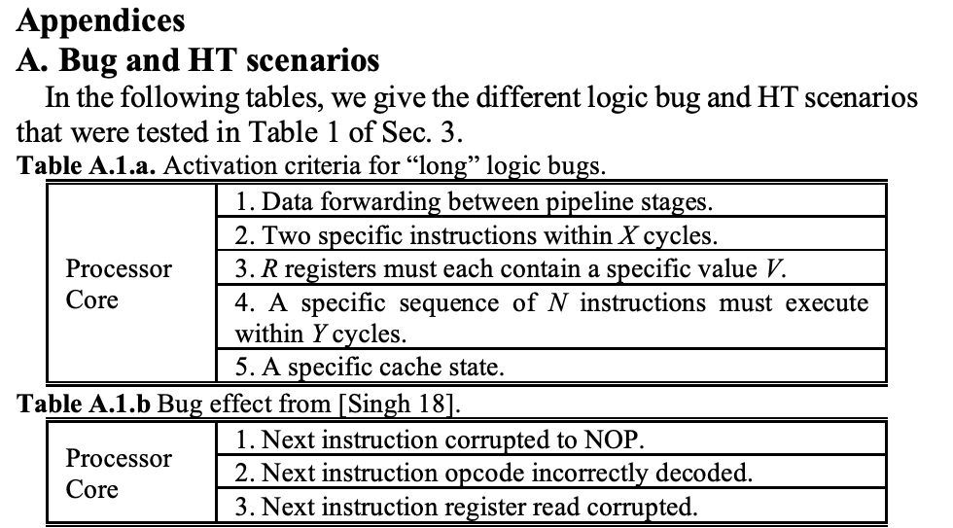
Status Updates - Hardware Trojans on V Scale
Notes:
Objective was to try and insert 5 pairs of trojan triggers (activation criteria) and payloads (effects)
Goals
Learn the design
Learn the tools
Learn the trojans

Slide 5
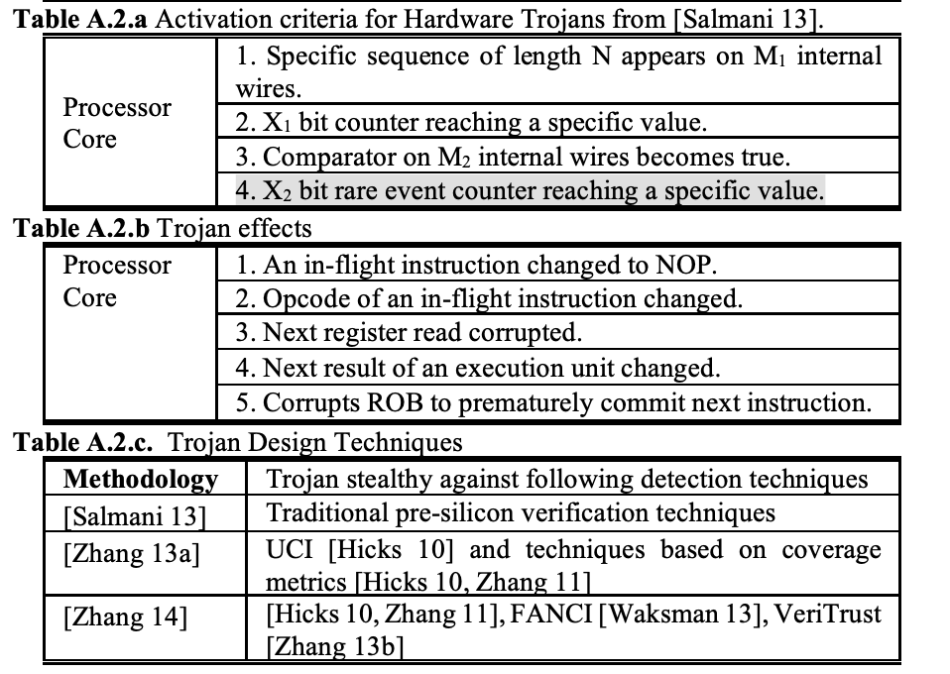

Slide 6
Trojan Examples

Slide 7
Trigger: 128b Counter Reaches Specific Value

Slide 8
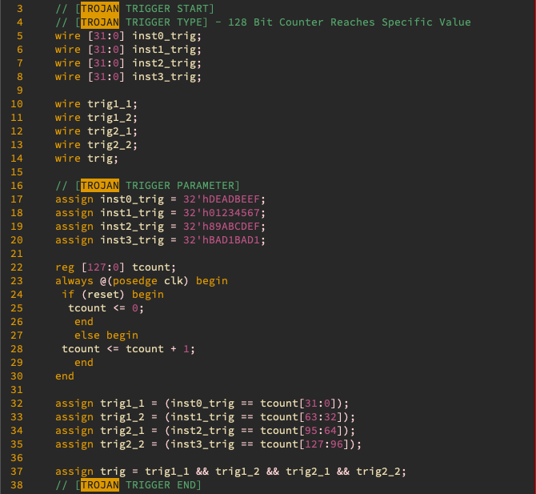

Slide 9
Payload: Opcode of In-Flight Instruction Changed

Slide 10
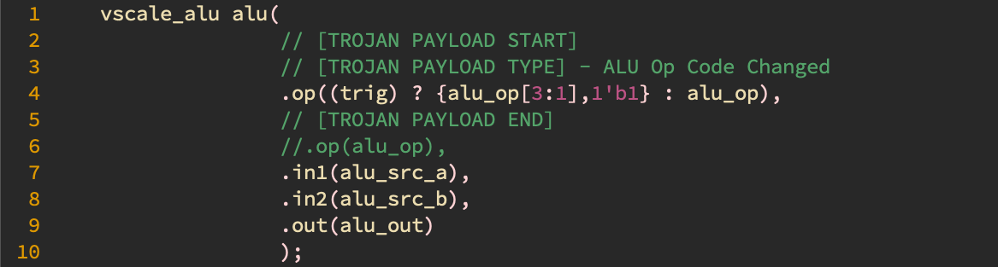

Slide 11
Self-Consistency Property

Slide 12
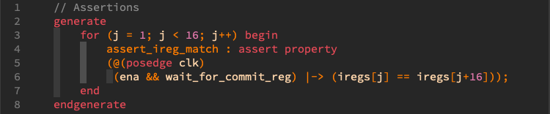

Slide 13
Self-Consistency Property Violated (Detected < 1s)

Slide 14
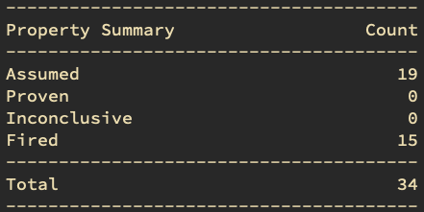

Slide 15
Case Study: Ticking Timebomb Trojans

Slide 16

“Ticking Timebomb Trojan” Nomenclature

Slide 17
“Ticking Timebomb Trojan” Nomenclature
Three Defining Traits of a TTT
State Saving Component (SSC)
Coalesced (e.g. One Counter Reg)
Distributed (e.g. Multiple Counters)
Increment Value
Uniform (e.g. counter <= counter + ‘d1)
Non-Uniform (e.g. counter <= counter + alu_opcode[2:0])
Increment Event
Periodic (e.g. increment at every clock edge)
Sporadic (e.g. increment during page faults)

Slide 18
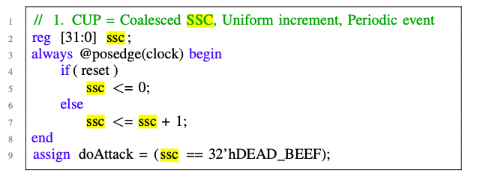
Previous Example
Coalesced / Uniform / Periodic (CUP)

Slide 19
Previous Example
Coalesced / Uniform / Periodic (CUP)

Slide 20
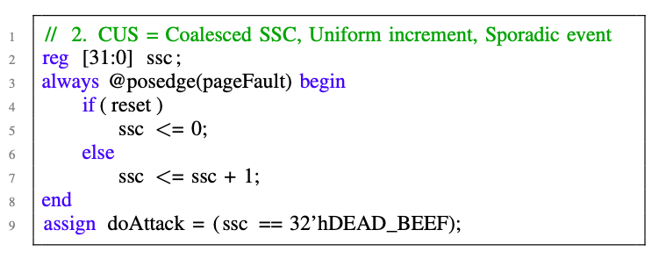
Coalesced / Uniform / Sporadic (CUS)

Slide 21
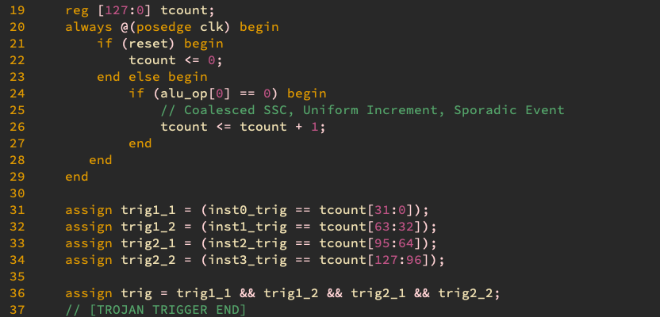
Coalesced / Uniform / Sporadic (CUS)

Slide 22
Detected ( < 1s)

Slide 23
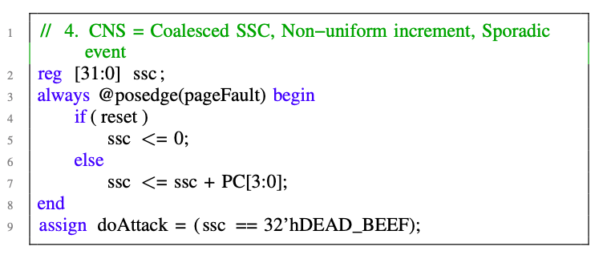
Coalesced / Non-Uniform / Sporadic (CNS)

Slide 24
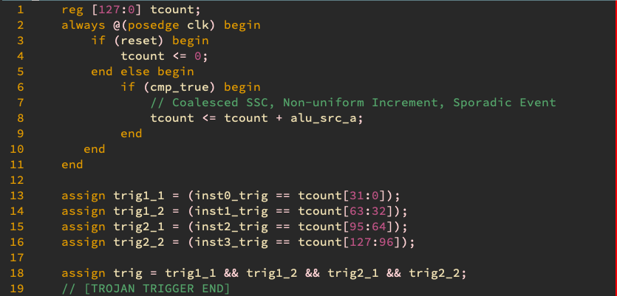
Coalesced / Non-Uniform / Sporadic (CNS)

Slide 25
Detected ( < 1s)

Slide 26
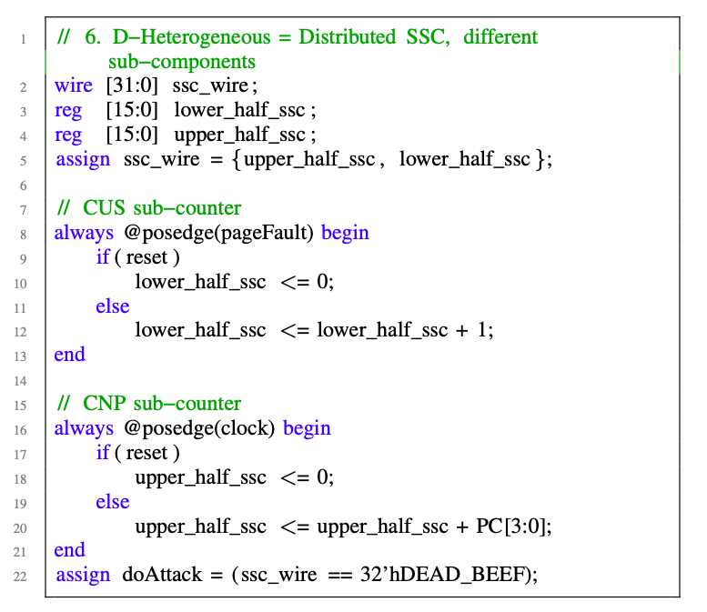
Distributed / Non-Uniform / Sporadic (DNS)

Slide 27
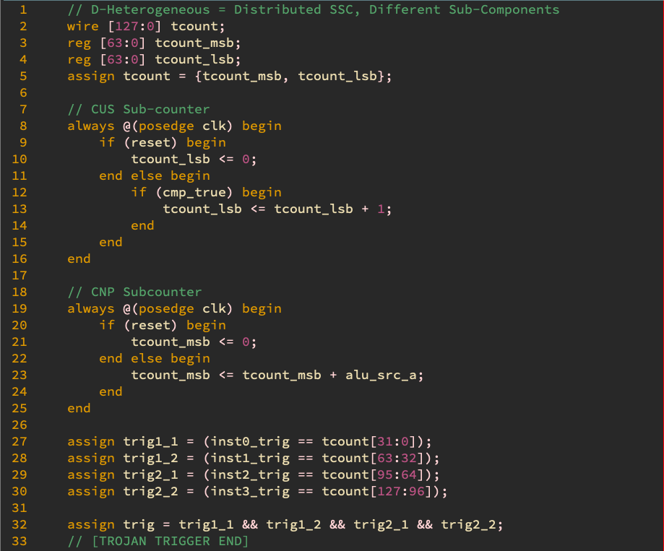

Slide 28
Detected ( < 1s)

Slide 29
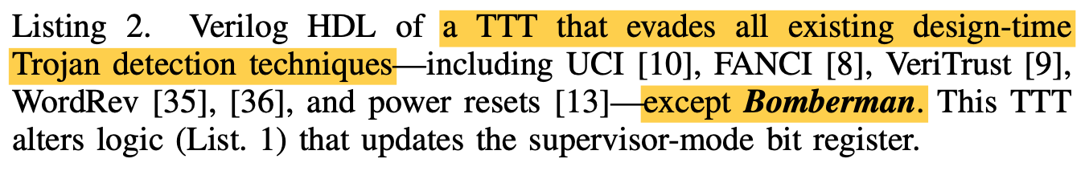

Slide 30
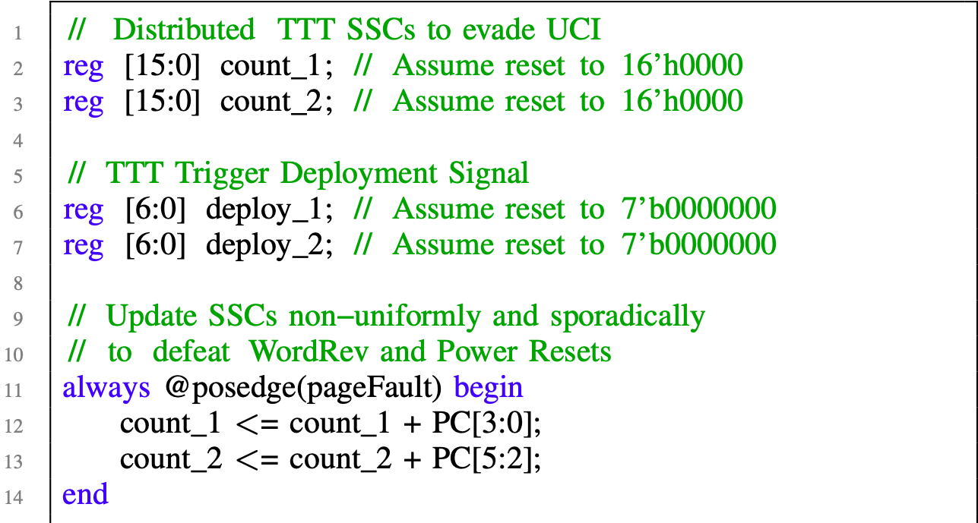

Slide 31
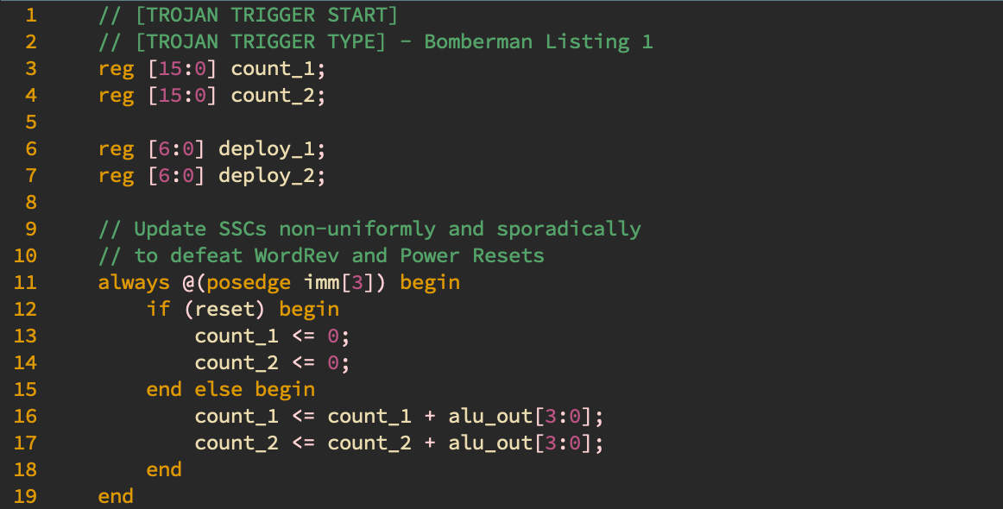

Slide 32
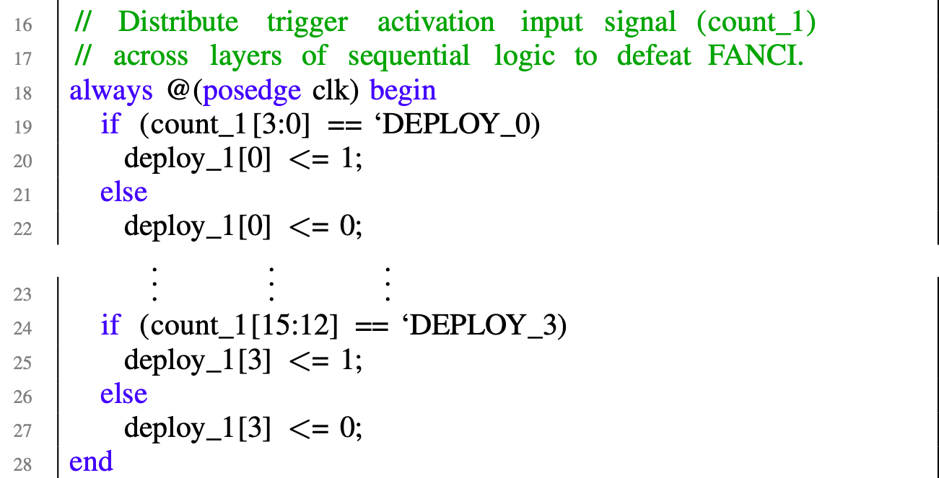

Slide 33
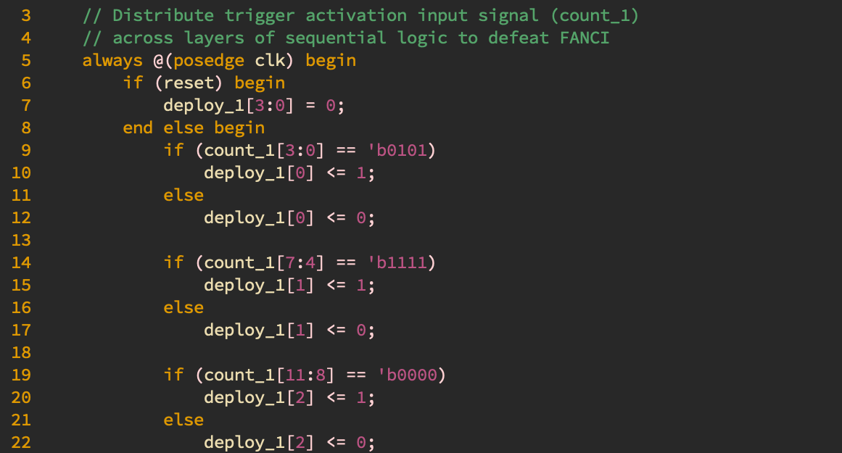

Slide 34
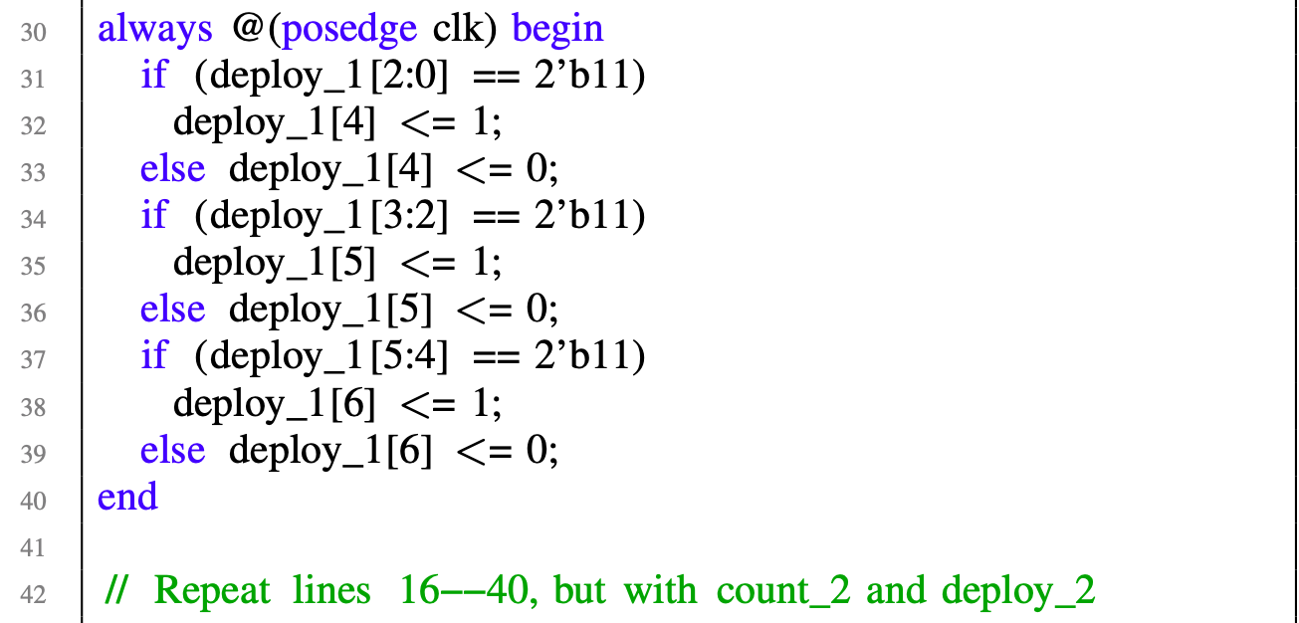

Slide 35
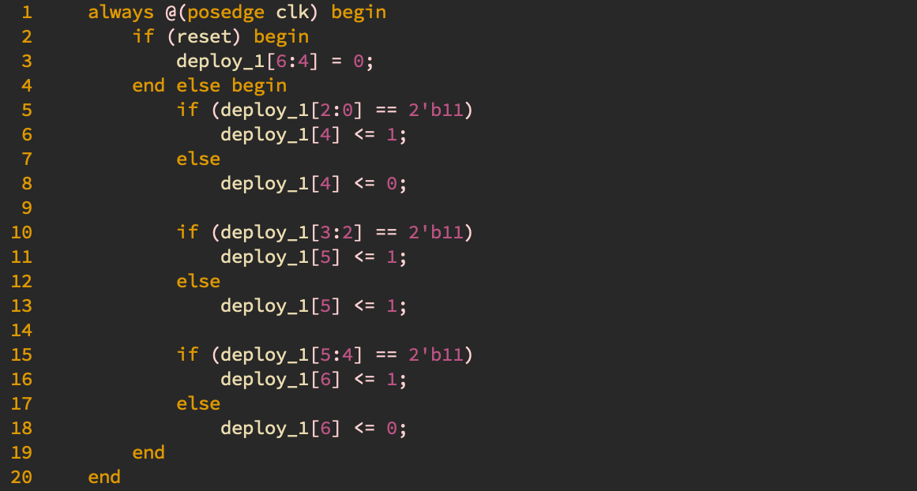

Slide 36
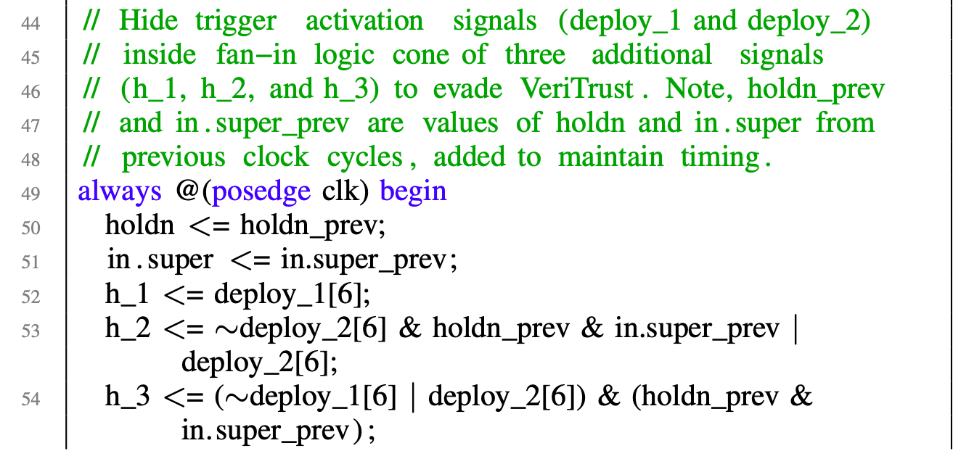
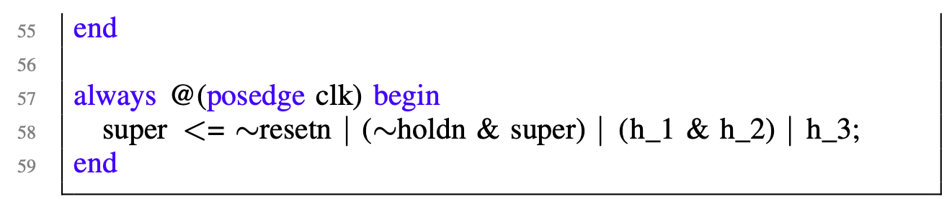

Slide 37
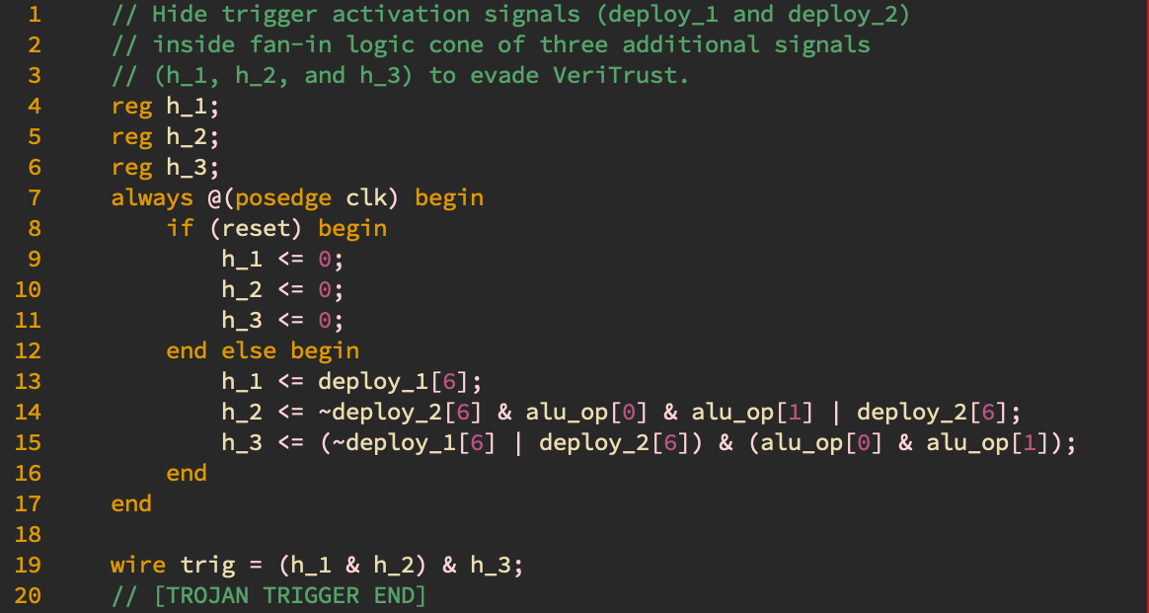

Slide 38
Detected (< 1s)

Slide 39
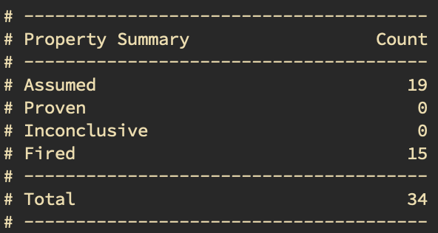
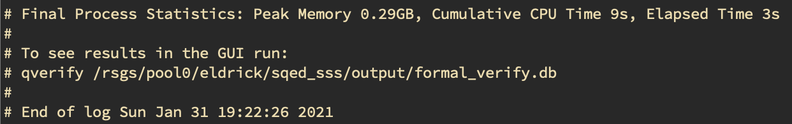
Notes:
All of these passed some initial ablation tests that I applied - setting certain components to zero, etc.

Slide 40
Issues

Slide 41
Constraining Trojan Starting States
Above bugs passed basic ablation experiments (making trigger unreachable)

Slide 42
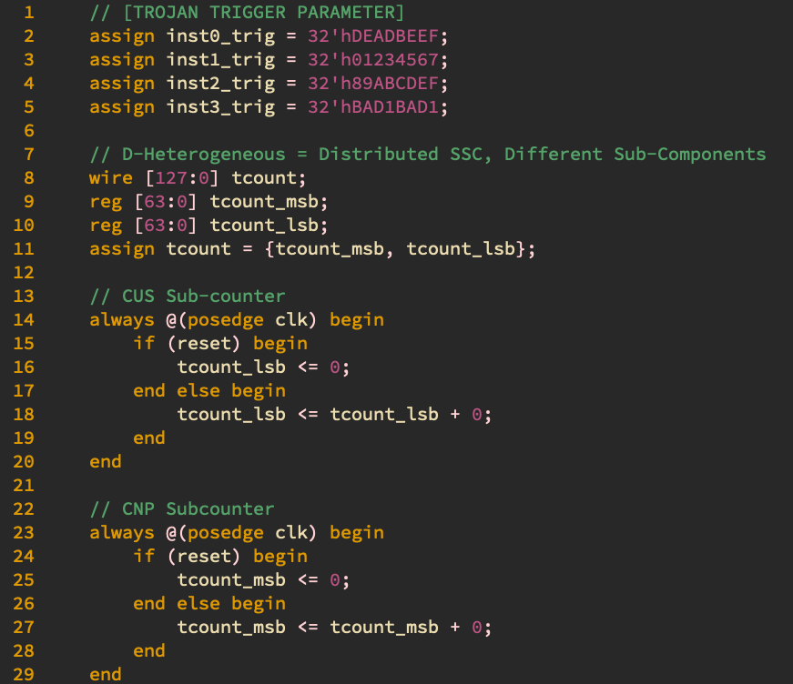
Counters cannot increment. No violation found
Notes:
All of these passed some initial ablation tests that I applied - setting certain components to zero, etc.

Slide 43
Constraining Trojan Starting States
Above bugs passed basic ablation experiments (making trigger unreachable)
However, other scenarios where the trigger is unreachable from reset will fire a counter example

Slide 44
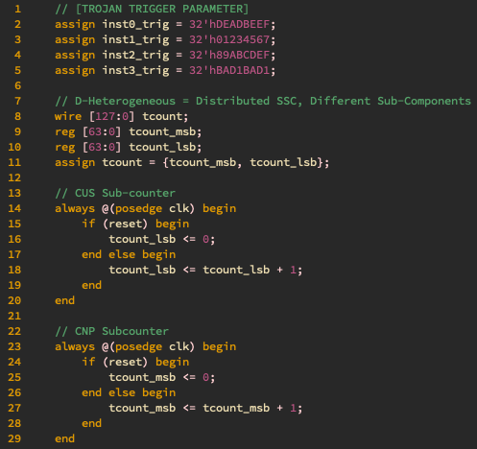
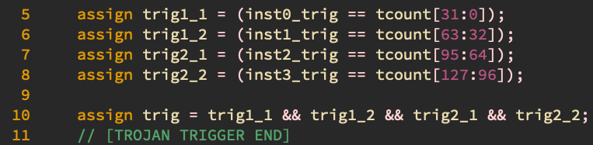
Trigger consists of different values for MSBs/LSBs
2) The MSBs and LSBs update in lockstep. They cannot trigger the payload from reset 3) But assertion is violated
Notes:
MSB <> LSB [0][1] [1][0] tcount _lsb = 00
tcount_msb = 00

Slide 45
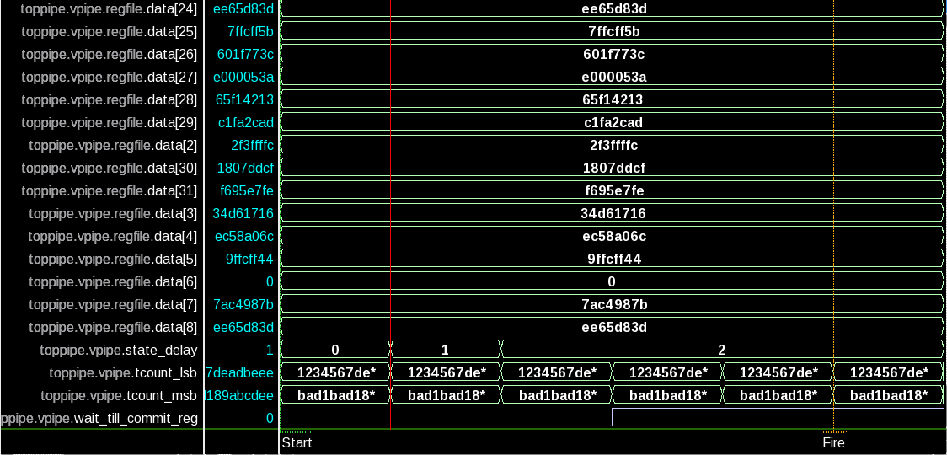
Notes:
All of these passed some initial ablation tests that I applied - setting certain components to zero, etc.

Slide 46
Constraining Trojan Starting States
Above bugs passed basic ablation experiments (making trigger unreachable)
However, other scenarios where the trigger is unreachable from reset will fire a counter example
How to constrain the trojan starting state?

Slide 47
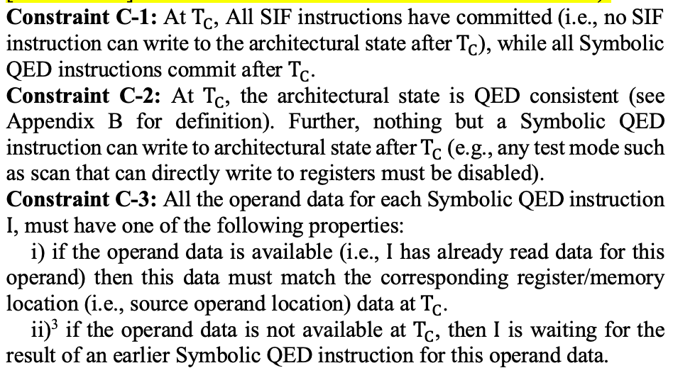
Status Update - SSS Constraints As Assertions

Slide 48
Status Update - SSS Constraints As Assertions
In the process of examining current assertions in vscale / ridecore implementations
Extensive modification done to vscale and ridecore - need to re-examine some of these simplifications

Slide 49
Upcoming Tasks
Refactor SQED + SSS Demo on RideCore
Demonstrate array of HW Trojans on RideCore
Re-examine current SSS constraints / assertions / assumptions on vscale & ridecore
Draft strategy to deploy technique on BOOM

